Slide 1
The Human Eye and the Colorful World Part 1: The human eye
CHAPTER NUMBER 11
Notes:
Hello and welcome to chapter 11, The Human Eye and the Colorful World .
Todays topic is

Slide 2
What is covered in this chapter?
Refraction working inside our eyes and other factors involved in vision.
The function of lens in human eyes.
The mechanism of fixing vision using spectacles.
Notes:
The topics that we will cover are:
Refraction working inside our eyes and other factors involved in vision.
The function of lens in human eyes.
The mechanism of fixing vision using spectacles.

Slide 3
THE HUMAN EYE
How does eye work?
Cornea
lens
Iris
The retina
Pupil
The image formed
Generation of electric signals.
Interpretation by brain.
Notes:
Lets vist our first topic, The human Eye:
The lens system allows the light inside This light falls on a light sensitive screen called retina The light enters the eyes through a small membrane called cornea.The eyeball is approximately spherical in shape with a diameter of about 2.3 cm.
Cornea : forms a slight bulge on the front surface of the eyeball

Slide 4
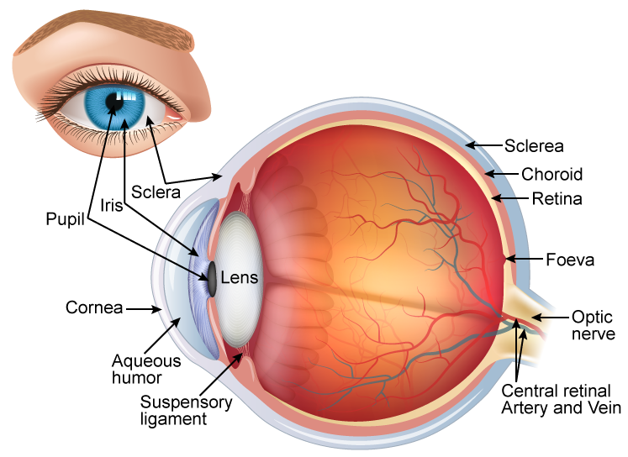
Notes:
The components of human eye are(point at the picture):
Sclera
Iris
Pupil
Cornea
Aqueous humor
Suspensory ligament
Sclerea
Choroid
Opric nerve
Central retinal Artery and vein

Slide 5
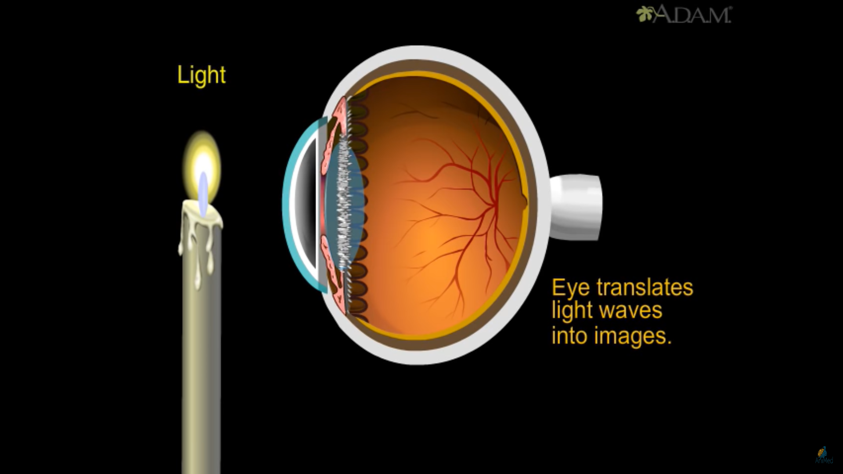

Slide 6
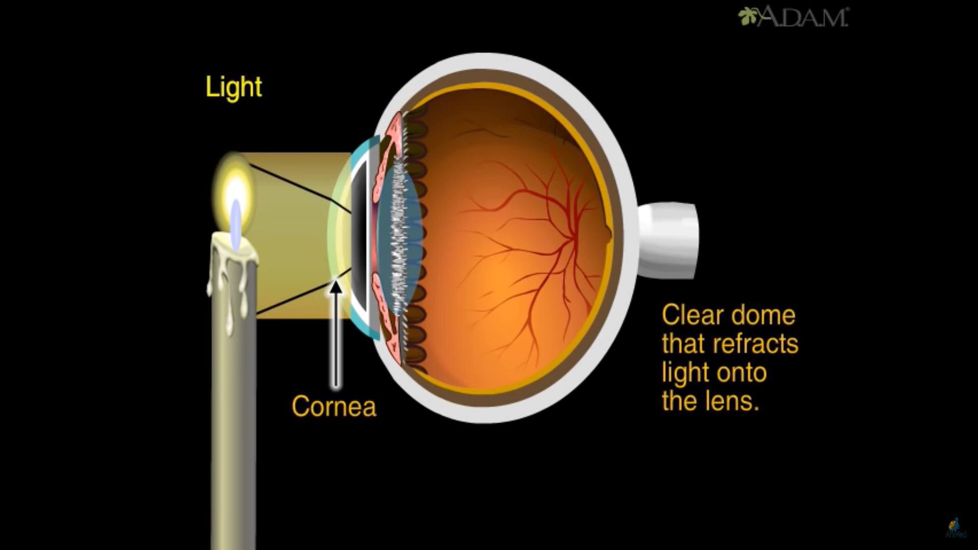

Slide 7
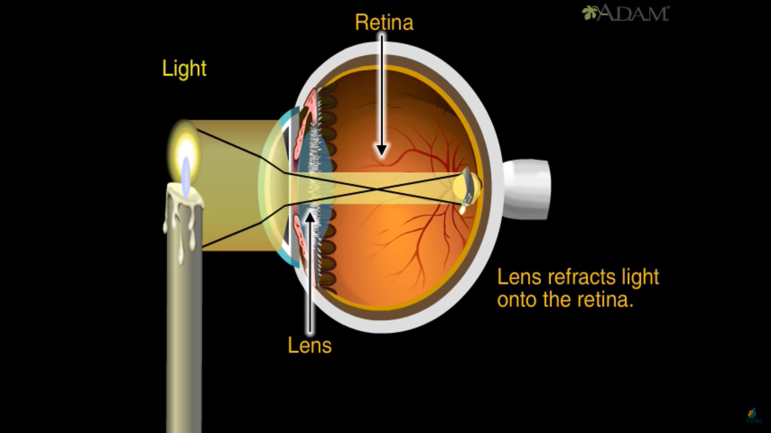

Slide 8
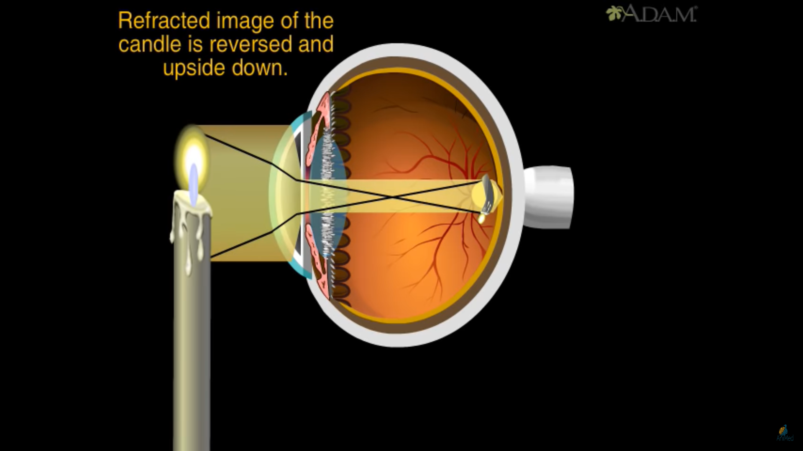

Slide 9
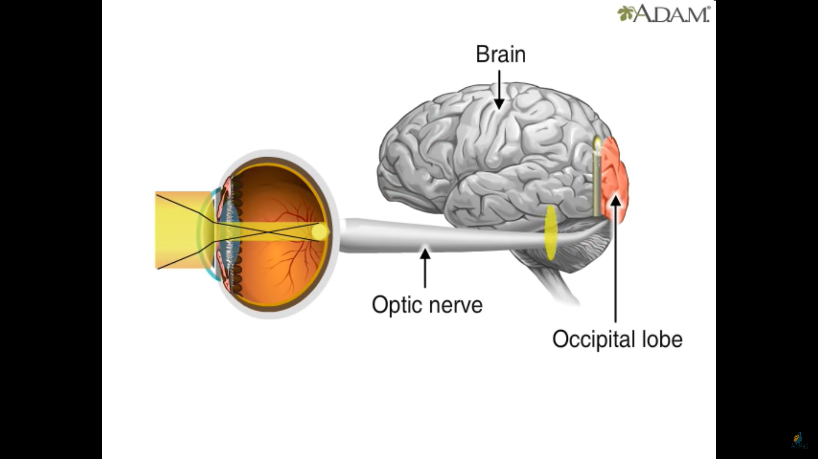

Slide 10
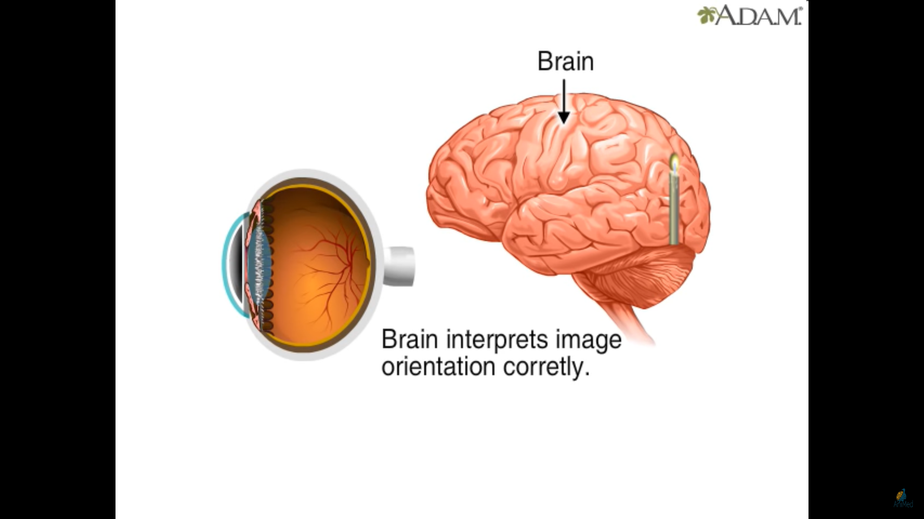

Slide 11
THANK YOU
Notes:
This is all for this part. I will see you in next part of this lecture

